Slide 1
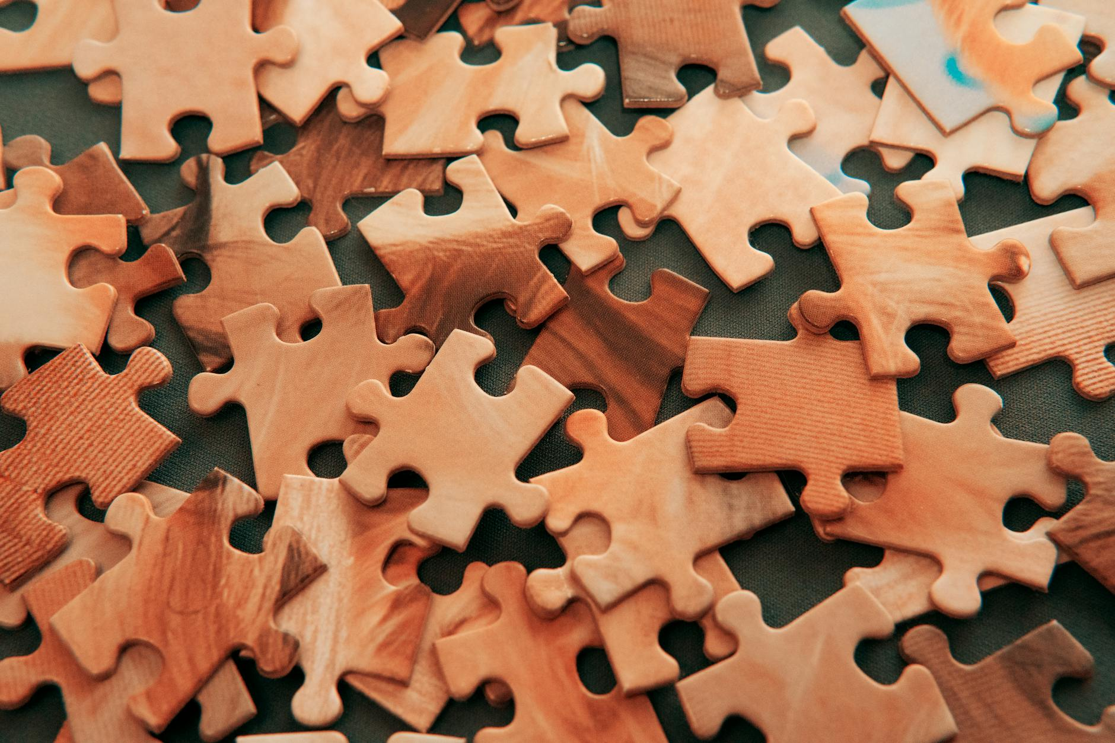
JIGSAW PUZZLE
PIECE IT TOGETHER
BY:
MOUNIKA GODHA
SHRUNIKESH DARASI

Slide 2
WHAT IS A JIGSAW PUZZLE?
A jigsaw puzzle is an engaging and demanding game in which players must put together interlocking pieces to finish a picture or pattern.
A puzzle might take hours to solve, with players meticulously piecing together each piece until the complete image is revealed.
Jigsaw puzzles are appropriate for all ages and ability levels because they are available in a variety of sizes and levels of complexity.
They are a well-liked past activity for kids and adults alike.

Slide 3
APPROACH AND TECHNIQUES:
The Main algorithm used in the code is not a single algorithm, but a combination of techniques for image processing and logic. Here are the key components:
Grid-Based Image Segmentation
Piece Shuffling
Image Reconstruction
Although it's not a single algorithm, this approach is similar to a dissection puzzle where an image is divided into pieces and needs to be reassembled.

Slide 4
LIBRARIES AND PLATFORMS USED:
Python
PIL (Python Imaging Library) / Pillow
Tkinter
Requests
IO (Input/Output)

Slide 5
ALGORITHM OVERVIEW:
Initialization
Shuffling
Solving
Checking for Solution

Slide 6
CODE sTRUCTURE:
The code we worked on has two classes.
Jigsaw puzzle class
PuzzleGUI class
Running the puzzle:initiating the execution of the puzzle game

Slide 7
DELIVERABLES:
Interactive Jigsaw Puzzle Game:
Graphical User Interface (GUI):
Image Processing:
Randomization:
Validation:
Download Image from URL:
Success Message:

Slide 8
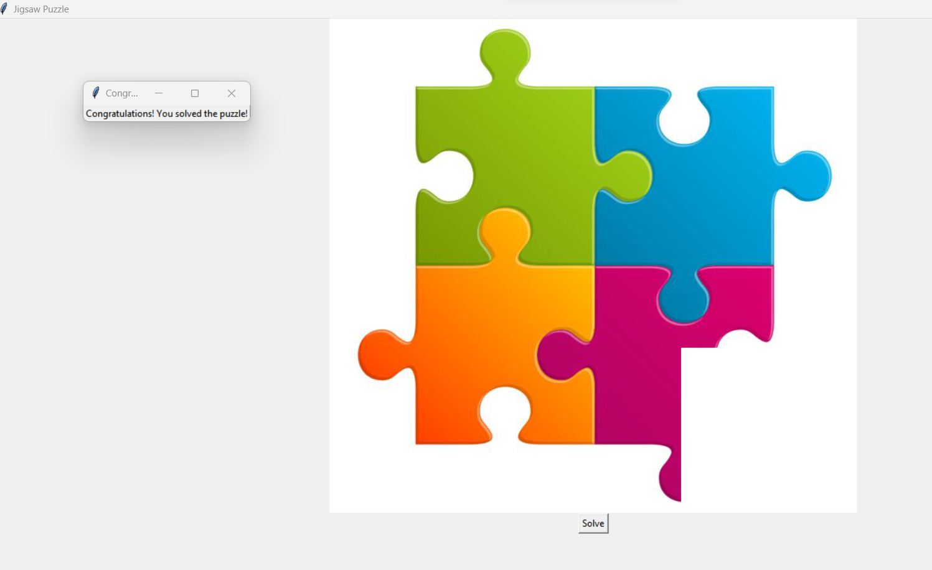
OUTPUT: SUCCESS MESSAGE

